Slide 1
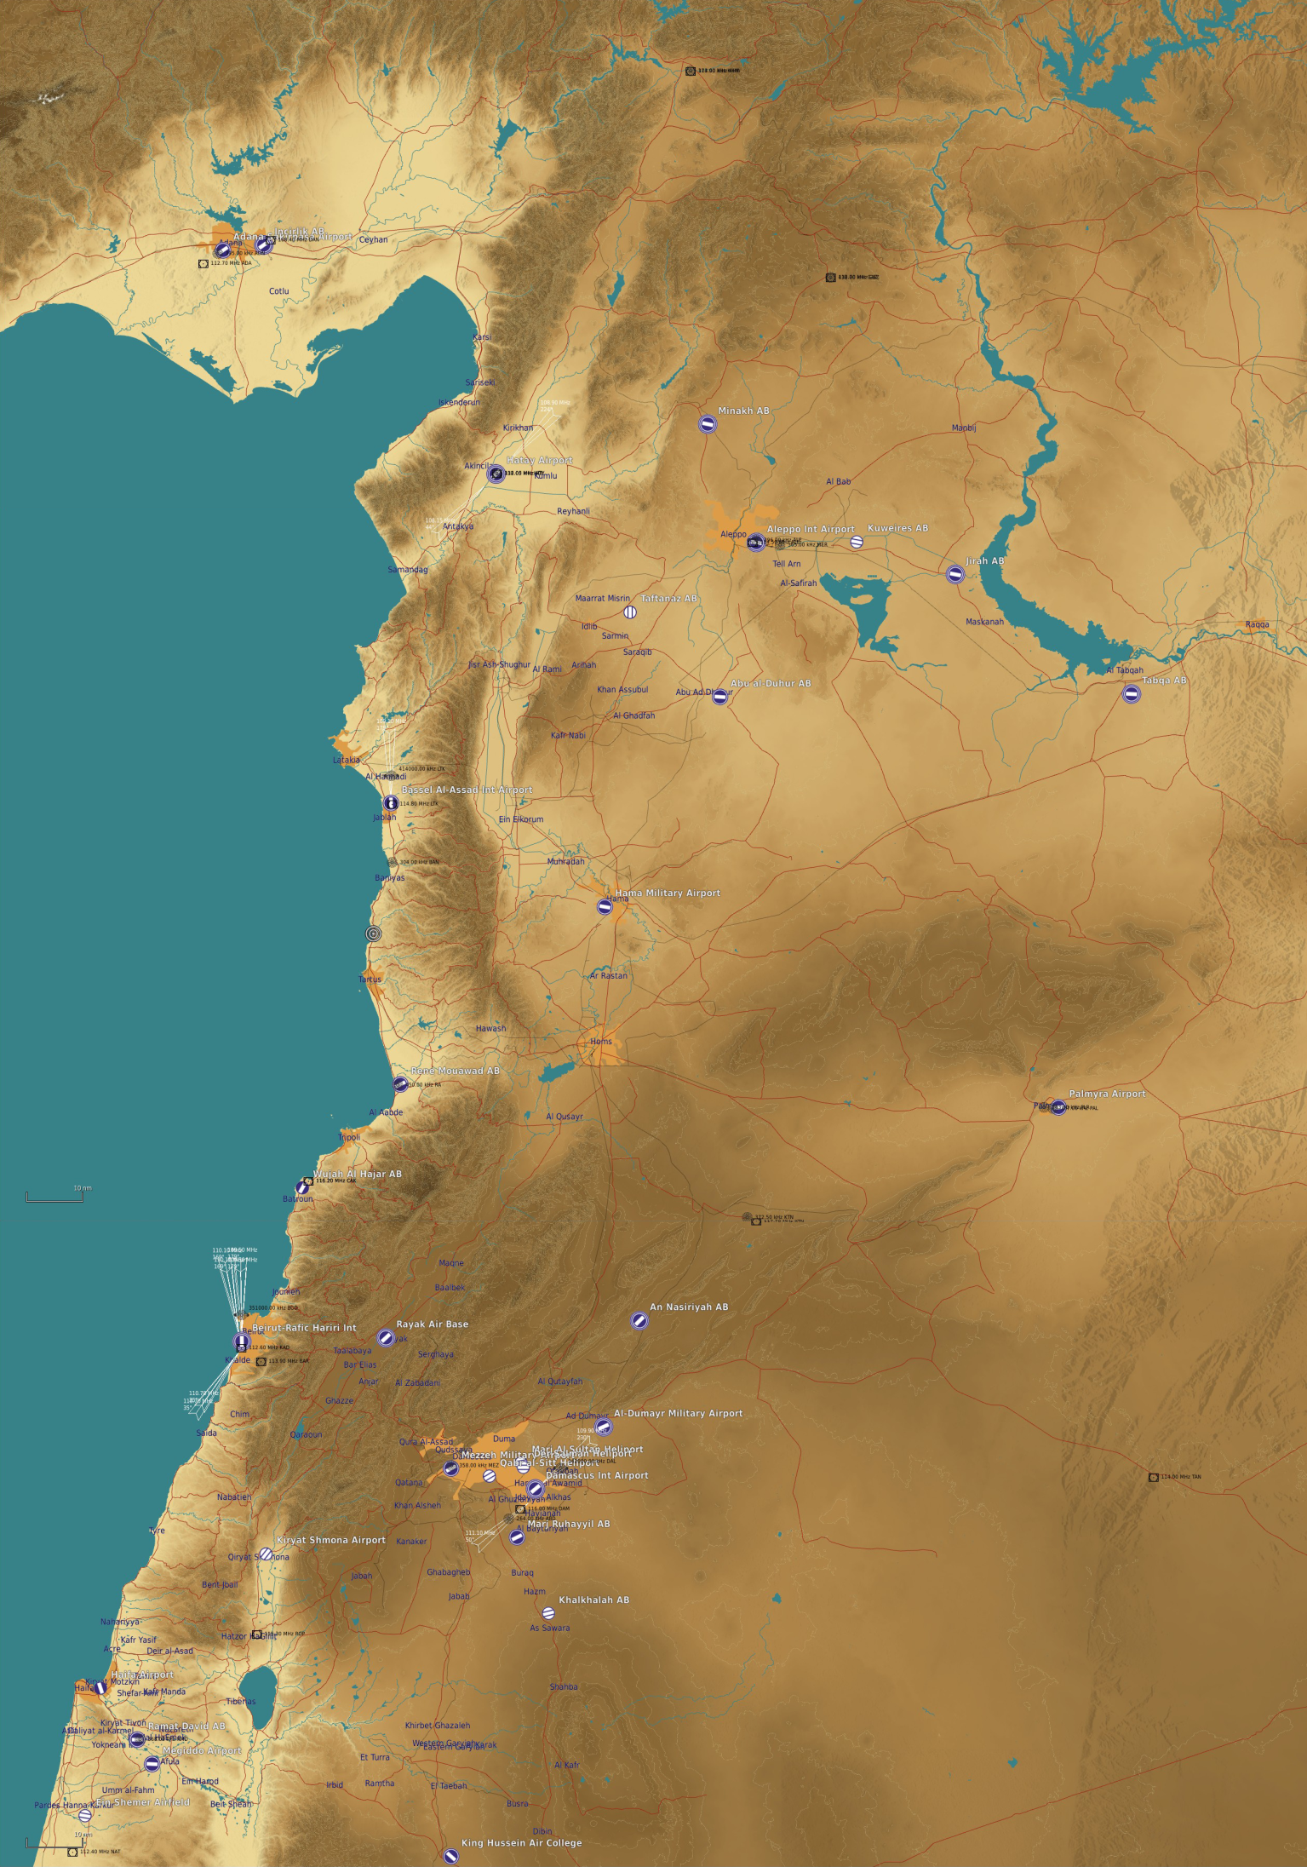
L39 SQN
Fligth training school
MINHAK AB
MI8- SQN
Fligh training
KUWEIRES AB
JIRAB AB
MiG-29 SQN
TAFTANAZ AB
ALEPPO INTL
L39 SQN
L39 SQN
MiG-29 SQN
MI8 SQN
Mi8 SQN
ABU UL DUHUR AB
TABQA AB
MiG-25 SQN
BASSEL AL-ASSAD INTL AIRPORT
MiG-21 SQN
MiG-21 SQN
MI8- SQN
MiG-29 SQN
IL-76SQN
MiG-23 SQN + 2 L39sqn
MiG-29 SQN
SU24 SQN
MiG-21 SQN
MiG-21 SQN MiG-21 SQN
MiG-29 SQN
HAMA MILITARY AIRPORT
MiG-23 SQN
PALMYRA AIRPORT
MiG-23 SQN
MiG-29 SQN
AN NASIRIYAH AB
MiG-25 SQN
MiG-23 SQN MiG-23 SQN
MiG-29 SQN
SA-324 Gazelle RW SQN
SA-324 Gazelle RW SQN
AL DUMARY MILITARY AIRPORT
MiG-21 SQN
MEZZEH military airport
AN26B SQN
MiG-23 SQN + SU-22 SQN
YAK-40
KHALKHALA HAB
MARJ RUHAYYIL military airbase
MiG-21 SQN MiG-21 SQN
MiG-29 SQN
MiG-23 SQN MiG-23 SQN
MI25 SQN
MiG-21 SQN
SU24 SQN
MiG-21 SQN

